Slide 1

A Prelim Analysis Into AP Computer Science Performance in Network 15
By: Arturo Cardiel

Slide 2
Comparisons to Make:
Passing scores of Students in Network 15 compared to other Networks, passing score comparisons across subjects
Comparing passing rates across Networks
Comparing passing scores and rates for AP Computer Science Principles across schools in Network 15
Demographical factors associated with passing rates for AP Computer Science Principles and other subjects

Slide 3
Data Sources
Data Given
CPS school data including school name, id, network, and school address (dropped due to missing values)
CPS AP Scores included student id, test school and name, annual school and name, AP score, and AP exam
Joined by matching annual school id and school id
Sample size is 42054 students
CPS School-Level Data
Racial/Ethnic Report 2022-2023
https://www.cps.edu/about/district-data/demographics/#a_racial-ethnic-report\
Extracted community area data of each school to join the given data
AP Score Distributions
Student Score Distribution – May 2022
https://apcentral.collegeboard.org/media/pdf/ap-score-distributions-by-subject-2022.pdf
Mean score of AP exams reflecting a total of 4,762,347 AP exams across different subjects
College Board Non-Profit Organization

Slide 4
Methodology
Cleaned, wrangled, and visualized data with SAS Studio using PROC SQL queries
Descriptive statistics to summarize and explore the data
Critical decisions
Replaced school address with community area data
School address had missing values
Injecting addresses and analyzing geographical data would be time consuming
Filtered data to only have passing scores meaning only those with a score above a 3
Grouped subjects to 3 categories other than Computer Science
Math, Science, Other
Limitations
CPS AP scores aren’t time stamped
Networks do not have an equal number of schools

Slide 5
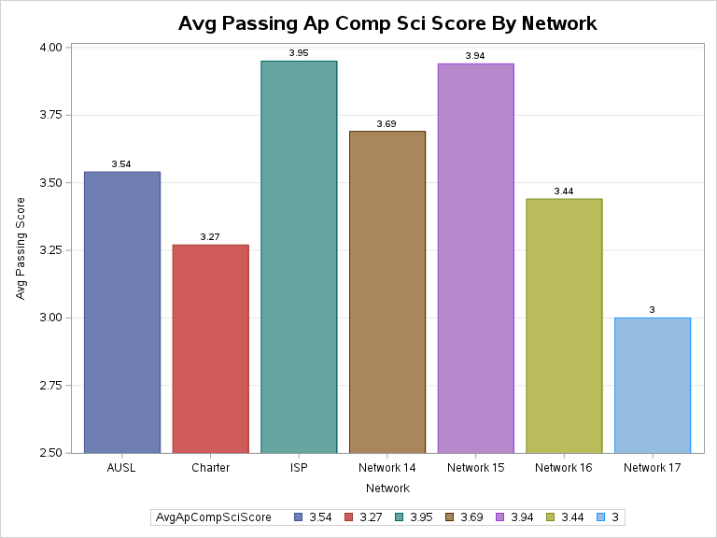
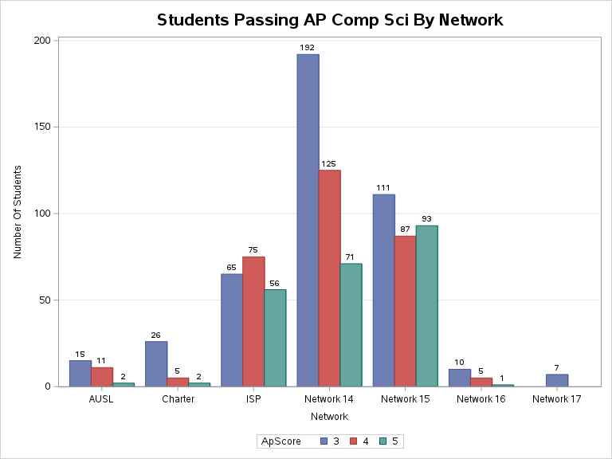
Network Level Comparisons
Large number of passing students in Network 14
Network 15 and ISP hold the highest Avg Passing Score

Slide 6
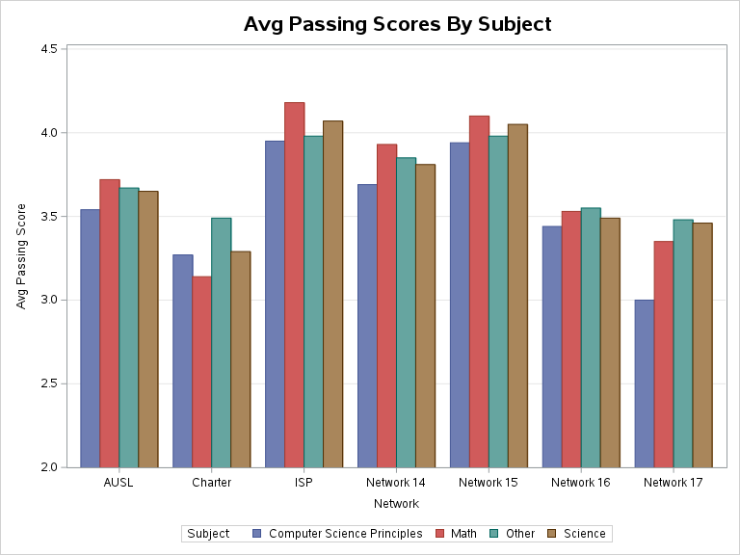
Subject Comparisons
Subject were broken down to those most similar to AP Comp Sci (Math, Science, Other)
Network 15 holds about the same averages across subjects with ISP
Network 15 and ISP top 2 highest averages across networks

Slide 7
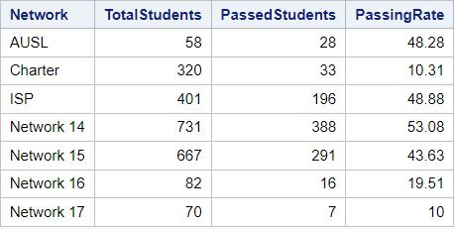
Passing Rates Compared to Nationwide Data
Network 15 passing rate 43.63%
ISP Avg Passing Score 48.88%
Network 14 having the highest at 53.08%
What factors into them having the highest passing rate?
Student Score Distribution has an average passing score of 3.68 with 62% passing rate
AP Computer Science Principals Passing Rate
https://apcentral.collegeboard.org/media/pdf/ap-score-distributions-by-subject-2022.pdf

Slide 8
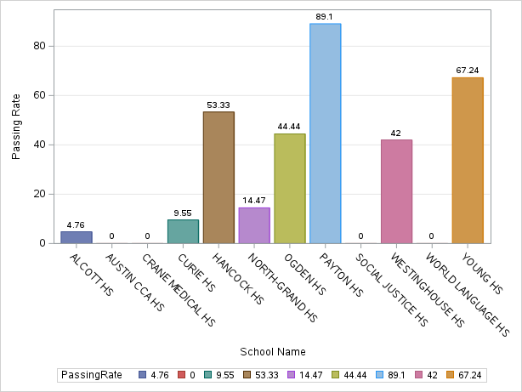
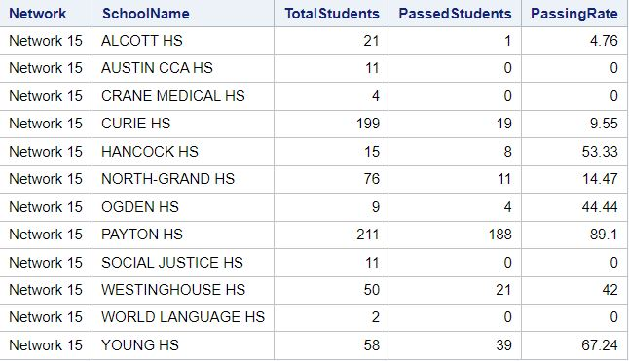
Passing Rates of AP Comp Sci Principles by Schools in Network 15
Schools with opportunities to grow are demonstrated
Study Payton and Young to see the allocation of resources and attitude towards CS
Opportunities in Alcott, Austin, Crane ,Curie, North-Grand, Social, and World.

Slide 9
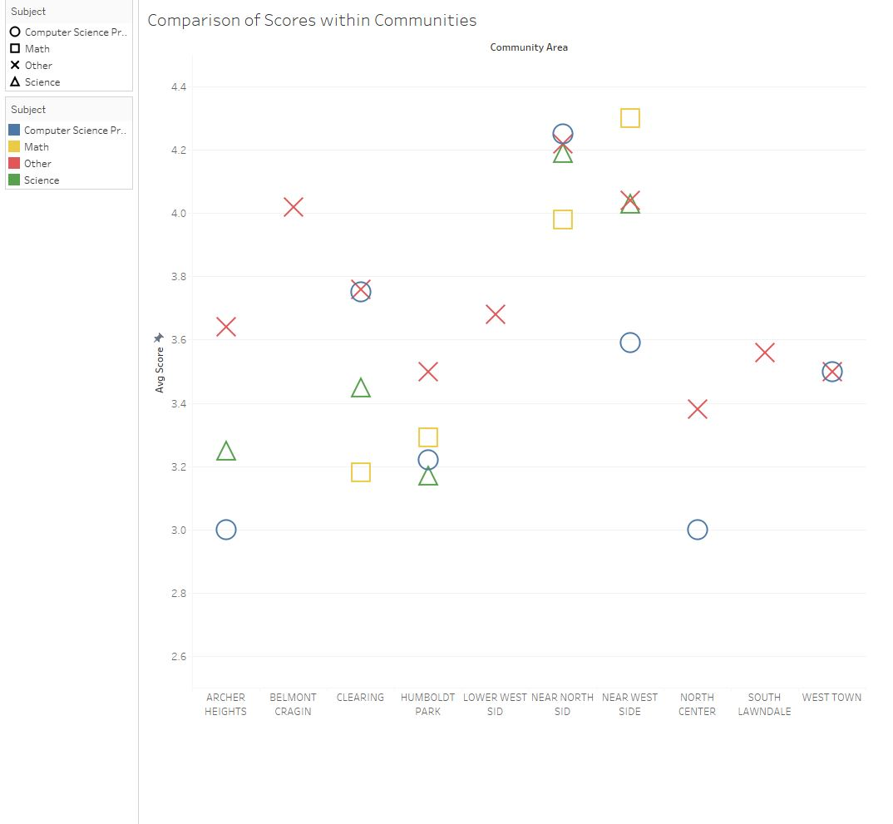
Comparisons Across Communities
Near North side has the highest avg score in Comp Sci, Science, and other
Near West side has the highest Math average
Archer Heights, Humboldt Park, North Center having the lowest Comp Sci scores. Why? Resources? Access to tech? Attitude towards tech?
Link to Tableau Dashboard:
https://public.tableau.com/app/profile/arturo.cardiel/viz/CommunityArea/Sheet1

Slide 10
Conclusion
Findings indicate that despite Network 14 having the highest passing rate, Network 15 and ISP show higher average passing scores in AP Computer Science Principles.
Network 15 and ISP have the highest average passing scores across different subjects
Archer Heights, Humboldt Park, and North Center have the lowest computer science scores, prompting further investigation.
Targeted interventions in these neighborhoods and schools to improve passing rates
Advocate for changes to enhance performance, ultimately benefiting the network as a whole.

Slide 11
Conclusion cont.
To further explore this topic and find why certain schools are performing worst than others we would need data with different factors
# of computers in a school
CS teachers
Survey Data (Attitude towards CS)
Access to tech outside of school
Access to after school programs
Make comparisons with Networks of equal size

